Slide 1
BENEFITS OF USING ICT
Very fast computational speed
Increased productivity
Technical Support
Quality support
Less Errors
Diligence
ETC..

Slide 2
APPLICATIONS OF ICT
Communication
Data storage and processing
Research
Product design and simulation
Broadcasting
Education
Automation
Specialized software
Graphics design

Slide 3
CLASSIFICATION OF COMPUTERS
Computers can be classified according to;
Usage
Implementation Technology
Design Features

Slide 4
Usage: 1
Super computers
Is a computer that leads the world in terms of processing capacity, particularly speed of calculation, at the time of its introduction.
Are used for highly calculation-intensive tasks such as weather forecasting, climate research, molecular modeling, physical simulations (such as simulation of airplanes in wind tunnels, simulation of the detonation of nuclear weapons). Military and scientific agencies are heavy users

Slide 5
Supercomputers…
Tianhe-2, a supercomputer developed by China’s National University of Defense Technology, retains its position as the world’s No. 1 system with a performance of 33.86 petaflops/s (quadrillions of calculations per second) counting a total of 3,120,000 cores. The total CPU plus coprocessor memory is 1,375 TiB
In computing, FLOPS (for Floating-point Operations Per Second) is a measure of computer performance, useful in fields of scientific calculations that make heavy use of floating-point calculations. For such cases it is a more accurate measure than the generic instructions per second.

Slide 6
Supercomputers…
A petaflop is a measure of a computer's processing speed and can be expressed as a thousand trillion floating point operations per second.
1 tebibyte = 2⁴⁰ bytes = 1099511627776bytes
1 terabyte (TB) =10¹² bytes = 1000000000000bytes

Slide 7
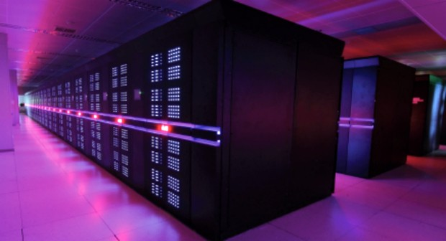

Slide 8
Usage: 2
Main Frame Computers
large, powerful, and expensive computers used mainly by large companies for bulk data processing (such as bank transaction processing).
mainframes support thousands of simultaneous users who gain access through "dumb" terminals

Slide 9
Mainframes..
Some mainframes have the ability to run (or "host") multiple operating systems and thereby operate not as a single computer but as a number of "virtual machines".
In this role, a single mainframe can replace dozens or hundreds of smaller PCs, reducing management and administrative costs while providing greatly improved scalability and reliability.

Slide 10
Supercomputers Vs. Mainframes
Supercomputers focus on problems which are limited by calculation speed while mainframes focus on problems which are limited by Input/output and reliability
Supercomputers are optimized for complicated computations that take place largely in memory, while mainframes are optimized for simple computations involving huge amounts of external data accessed from databases
Supercomputers used by science and the military, while mainframes target business and civilian government applications

Slide 11
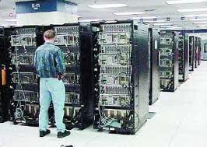

Slide 12
Usage: 3
Mini- Computers
are a largely obsolete class of multi-user computers which made up the middle range of the computing spectrum, in between the largest multi-user systems (mainframe computers) and the smallest single-user systems (microcomputers or personal computers)
They usually took up one or a few cabinets, compared with mainframes that would usually fill a room.
Today they are referred to as "servers", (typically file server and back-end database software, including email and web server software).

Slide 13
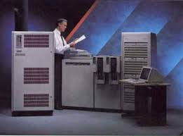

Slide 14
USAGE: 3
Workstation
A workstation, such as a Unix workstation, RISC workstation or engineering workstation, is a high-end desktop or deskside microcomputer designed for technical applications
Workstations usually offer higher performance than is normally seen on a personal computer, especially with respect to graphics, processing power, memory capacity and multitasking ability

Slide 15
USAGE: 4
Micro-Computers
A personal computer is an inexpensive microcomputer, originally designed to be used by only one person at a time.
Personal / Desktop Computers (PC)
Laptops
Notebooks

Slide 16
USAGE 5:
Hand-held Computers
Personal Digital Assistant – PDA
handheld devices that were originally designed as personal organizers, but became much more versatile over the years. A basic PDA usually includes a clock, date book, address book, task list, memo pad and a simple calculator.
Mobile Phones
Tabs

Slide 17
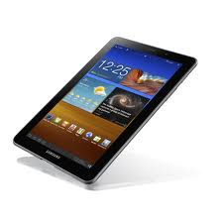
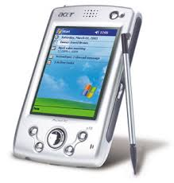

Slide 18
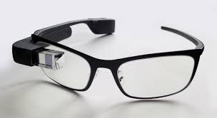
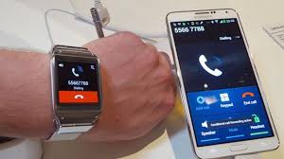
USAGE 6:
Wearable Computer
is a small portable computer that is designed to be worn on the body
during use.

Slide 19
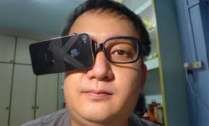

Slide 20
Classification by Implementation Technology
Mechanical
Electro-mechanical e.g. relays
Electrical

Slide 21
Classification by Design Features
Digital vs Analog
Digital computers process discrete numeric or symbolic values, while analog computers process continuous data signals. Analog- robotics
Storage
Development of the first stored-program computers of the type used today.

Slide 22
Contd…
Binary vs Decimal
A significant design development in digital computing was the introduction of binary as the internal Numeral system. This removed the need for complex carry mechanisms required for computers based on other numeral systems, such as the decimal system.
Programmability
The ability to program a computer - provide it with a set of instructions for execution- without physically reconfiguring the machine is a fundamental design feature of most computers.

Slide 23
Classification by Capability
General-Purpose Computers
By definition a general-purpose computer can solve any problem that can be expressed as a program and executed within the practical limits set by; the storage capacity of the computer, the size of program, and speed of program execution.
Special Purpose Computers
These computers are programmed once in the factory and only seldom, if ever, reprogrammed.

Slide 24
Contd…
Single-Purpose Computers
Single-purpose computers were the earliest form of computing device. Given some inputs they could calculate the result of the single function that was implemented by their mechanism.

Slide 25
COMPUTER INFORMATION SYSTEMS
Elements of a CIS
(a) People
(b) Data/information
(c) Methods (Procedures)
(d) Equipment( hardware and software)
(e) Communication

Slide 26
COMPUTER SOFTWARE
Operating System
Graphical User Interface(GUI) & Command Line User Interface(CLI)
Application Software
Utility Software
Proprietary Software
Software for mobile

Slide 27
Assignment
Choose two ICT innovation
Invented in the last decade
That you think is the best
Link to the Milledium Development Goals
Due Monday

